Slide 1

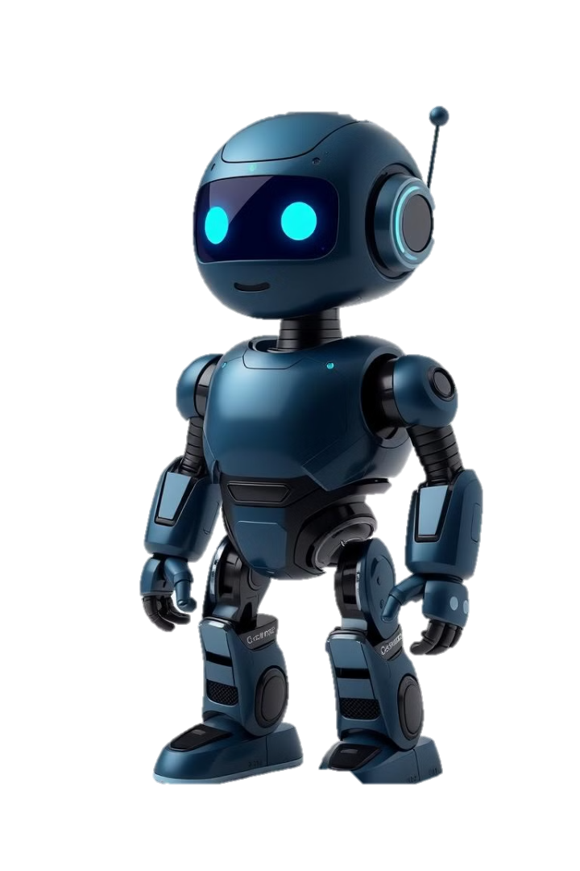
An AI-Driven Personal Wellness Solution
Immanuel Fernandes
📞+91 77387 54547
📧 immanuelfernandes333@gmail.com
Sahil Bengloor
📞+91 77380 07968
📧 sahilbengloor185@gmail.com
Atharva Deorukhkar
📞+91 90293 60971
📧 atharvadeorukhkar4@gmail.com
Shubharaj Kamaraj
📞+91 99309 08327
📧 shubharajkamaraj1964@gmail.com
“Empowering Your Wellness Journey with Intelligent Precision”

Slide 2


PROBLEM STATEMENT
AI-Powered Mental Health Companion
An AI-powered mental health companion that provides personalized support and guidance for emotional well-being and resilience.

Slide 3

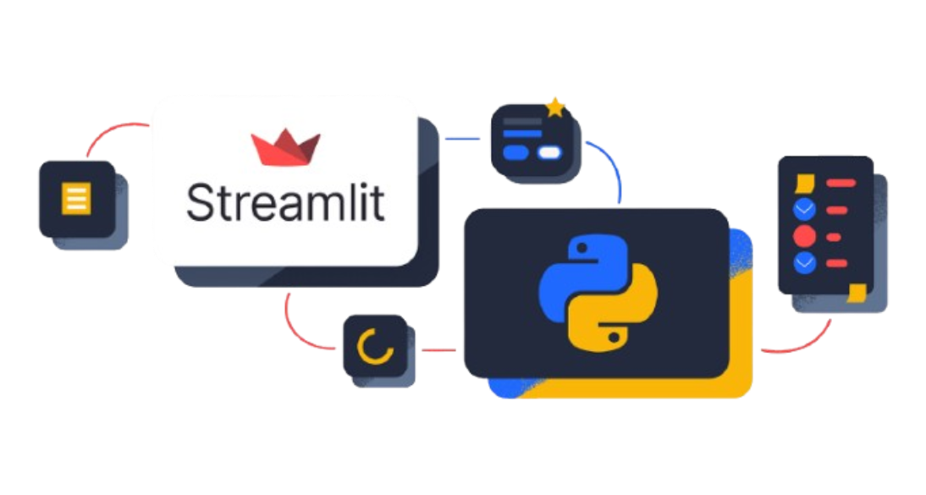

Technologies Used
Python Streamlit
C# ASP.Net
For building the user interface and web app.
For backend development and API integration.
Cohere LLM API
MSSQL Database
For natural language processing and sentiment analysis.
For secure storage and management of user data.

Slide 4
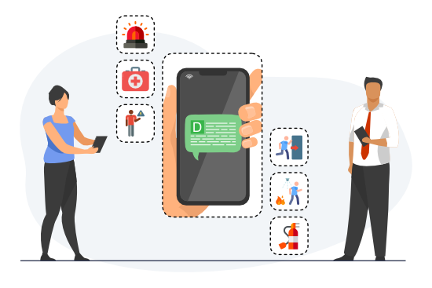
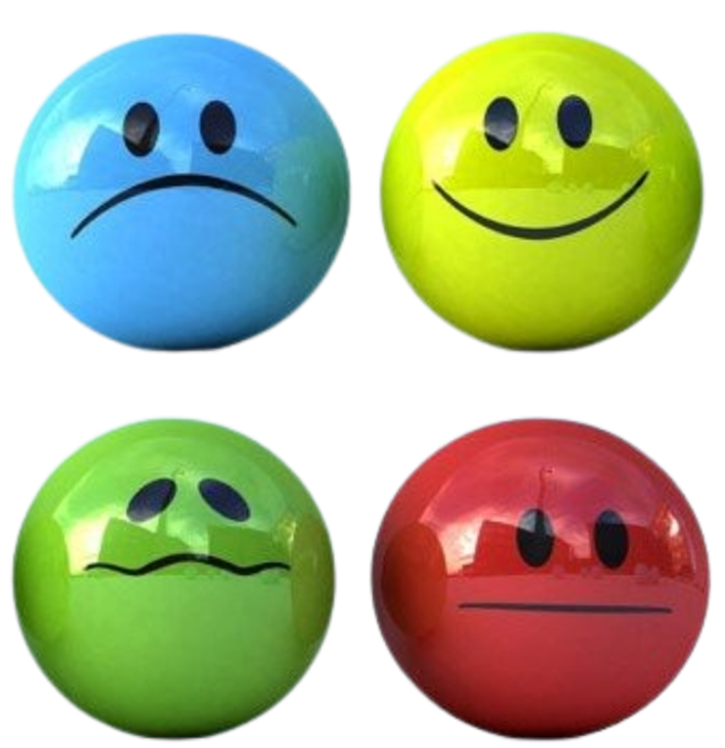

Key Features
Mood Detection
Emergency Alert
Wellness Recommendations

Slide 5







FUTURE SCOPE & ENHANCEMENTS
Phase - 1
Phase - 2
Phase - 3
Offline Capability
Multimodal Input
Better Gamified Tracking
Integrate voice and image recognition for a more holistic mood assessment.
Notes:
https://soil-enthusiast-2024.netlify.app/
https://lnk.bio/SoilRevolution
https://youtu.be/OevoFNRJsko?si=-69Fwg5KWMi68bCO

Slide 6
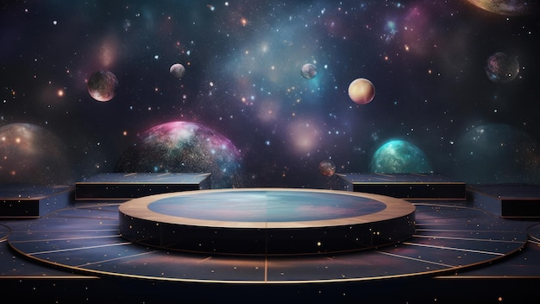
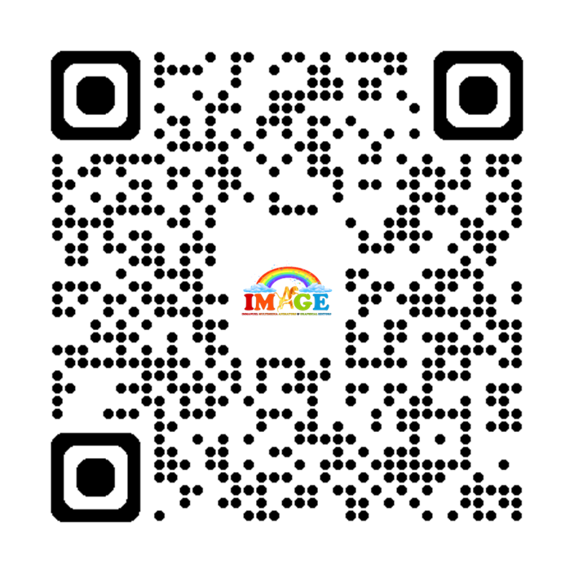
Scan To Know More

